Slide 1
Dynamic Modelling

Slide 2
Objectives
Understand what is a Dynamic model
Understand the difference between a Difference GMM and a system GMM
FIt a one-step difference GMM
Fit a two step Difference GMM
Fit a one-step System GMM
Fit a two-step System GMM
Deciding between a Difference GMM and System GMM

Slide 3
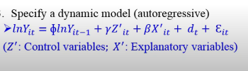
What is a Dynamic model?
A dynamic panel model is a regression model where the dependent variable depends on its own past values. A commonly used specification for Generalized Method of Moments (GMM) estimation is the dynamic autoregressive model:
where:
yit​ = Dependent variable for entity iii at time ttt
yi,t−1​ = Lagged dependent variable
Xit​ = Vector of time-varying explanatory variables
Zi​ = Time-invariant entity-specific characteristics (fixed effects)
δt​ = Time-specific effects (to control for macroeconomic shocks)
εit​ = Error term

Slide 4
What is A GMM model?
The Generalized Method of Moments (GMM) is an econometric technique used to estimate parameters in models where endogeneity, heteroskedasticity, or autocorrelation are concerns. It is widely applied in panel data analysis and is especially useful when ordinary least squares (OLS) and fixed-effects models produce biased results due to endogeneity.

Slide 5
Why Use GMM?
GMM is preferred over other estimation methods when:
✅ Endogeneity is present (e.g., when regressors are correlated with the error term).
✅ Lagged dependent variables are included, making OLS estimates biased.
✅ Panel data (multiple observations over time for each entity) is used, and fixed/random effects may not fully control for omitted variable bias.
Controls for: Unobserved panel heterogeneity

Slide 6
GMM specifics
N(number of groups) > T(time)
Instruments Z must be exogenous
Z<= N

Slide 7
Types of GMM
Difference GMM
System GMM

Slide 8
Wait ….
You cannot mention GMM without mentioning the following papers
Holtz-Eakin, Newey, and Rosen (1988, Econometrica 56: 1371–1395)
Arellano and Bond (1991, Review of Economic Studies 58: 277–297)
Arellano and Bover (1995, Journal of Econometrics 68: 29–51)
Blundell and Bond (1998, Journal of Econometrics 87: 115–143).

Slide 9
Difference GMM
Arellano & Bond (1991)
Corrects endogeneity by:Transforming all regressors through differencing
Removing fixed effects
First difference transformation has a weakness –
subtracts the previous observation from the contemporaneous one, thereby magnifying gaps in an unbalanced panel.

Slide 10
System GMM…
Arellano & Bover (1995) and Blundell & Bond (1998)
Corrects endogeneity by:
Introducing more instruments to dramatically improve efficiency
Transforming the instruments to make them uncorrelated (exogenous) with the fixed effects
Builds a system of two equations: the original equation and the transformed one.
Uses orthogonal deviations – Instead of subtracting the previous observation from the contemporaneous one, it subtracts the average of all future available observations of a variable. No matter how many gaps, it is computable for all observations except the last for each individual, so it minimizes data loss. ​

Slide 11
One-Step vs. Two-Step GMM
1. One-Step GMM
Uses initial weighting matrix based on the assumption of homoskedastic errors (constant variance).
The standard errors may be biased if heteroskedasticity is present.
2. Two-Step GMM (More Efficient)
First, one-step GMM is run to get residuals.
Then, the residuals are used to compute an improved weighting matrix, adjusting for heteroskedasticity.
This step provides more efficient estimates and robust standard errors.

Slide 12
GMM diagnostics
Two tests for instruments validity:
Hansen (1982) J test and Sargan (1985) test of over-identifying restrictions: tests the null hypotheses of overall validity of the instruments used.
Failure to reject these null hypotheses gives support to the choice of the instruments.
Test for autocorrelation/serial correlation of the error term:
Tests the null hypothesis that the differenced error term is first and second order serially correlated.
Failure to reject the null hypothesis of no second-order serial correlation implies that the original error term is serially uncorrelated and the moment conditions are correctly specified (that is, the value of AR(2) > 0.05).

Slide 13
GMM and xtabond2
xtabond2 is an improved version of xtabond, implementing Arellano-Bond (1991) and Blundell-Bond (1998) system GMM.
It is used for dynamic panel data models where:
The dependent variable depends on its past values (lagged dependent variable).
Independent variables may be endogenous or predetermined.
There are fixed effects that need to be accounted for.

Slide 14
Types of GMM in xtabond2
Difference GMM (Arellano-Bond, 1991)
First-differences the data to remove fixed effects.
Uses lagged levels of variables as instruments.
Suitable when independent variables are strictly exogenous or weakly endogenous.
System GMM (Blundell-Bond, 1998)
Uses lagged levels and lagged differences as instruments.
Improves efficiency when variables are persistent over time.
Recommended when Difference GMM suffers from weak instrument issues.

Slide 15
Key Features of xtabond2
Endogeneity Control: Uses internal instruments (lagged values) to mitigate bias from endogeneity.
Efficiency: System GMM is more efficient when variables are highly persistent.
Robustness Checks:
AR(2) test: Checks for second-order serial correlation in differenced residuals.
Hansen Test: Tests for overidentifying restrictions (validity of instruments).

Slide 16
One-step Difference GMM
Why estimate one-step difference GMM?
Arellano-Bond estimators have one- and two-step variants.
One-step difference GMM is the initial regression (Roodman, 2009).
Many applied works use one-step estimates because simulation studies suggest very modest efficiency gains from two-step, even in the presence of heteroscedasticity.

Slide 17
Interpreting the output
Statistics to look out for…
Hansen statistic → valid instruments?
AR(2) statistic → 2ⁿᵈ order autocorrelation?
Lagged dependent variable → check p-value
Other regressors → check p-value
No. of instruments (I) vs. no. of groups (G) → I < G
F-statistic → joint significance?

Slide 18
Example for our synthetic data
import delimited "dynamic_panel_data_with_numeric_time_dummies.csv", clear xtset id time // Declare panel structure
xtabond2 y L.y x1 x2 time_2-time_10, gmm(L.y, collapse) iv(x1 x2) twostep

Slide 19
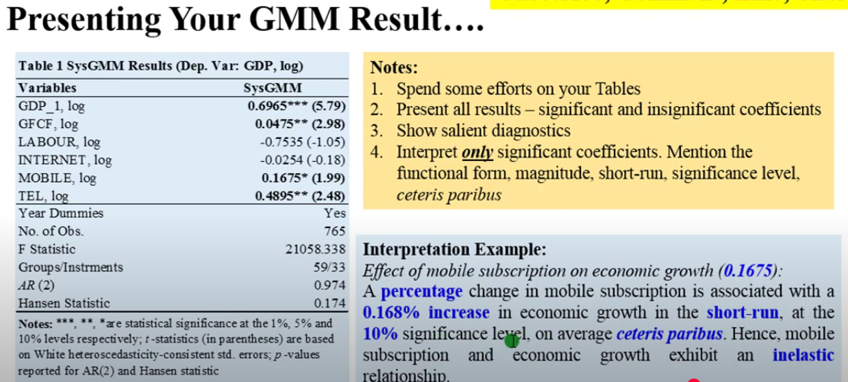
Presenting your results

Slide 20
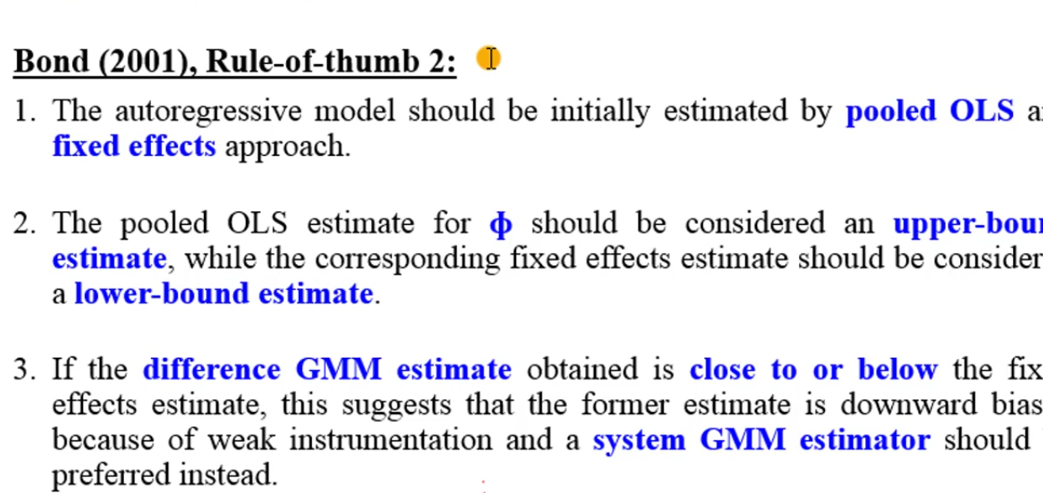
Decision

Slide 21
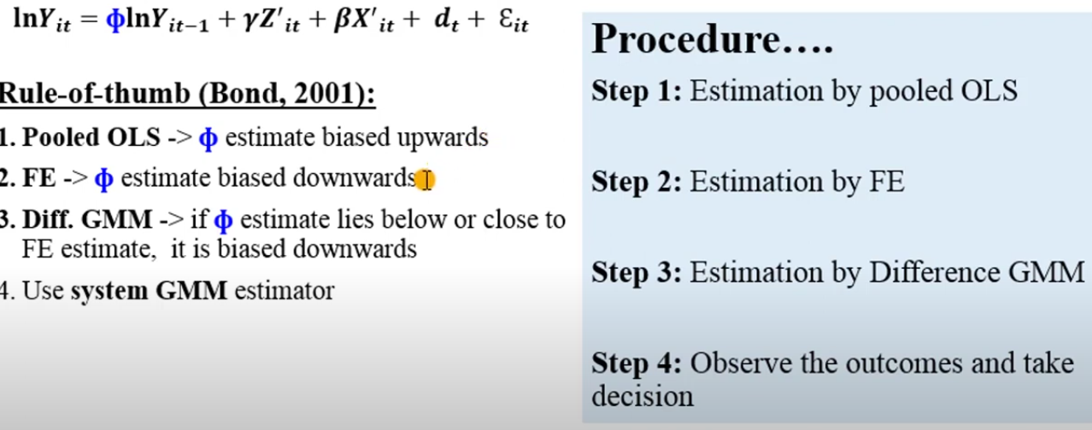
Decision rule

